Slide 1
Introduction to Data Science Data Mining for Business Analytics
Brian d’Alessandro
VP – Data Science, Dstillery
Adjunct Professor, NYU
Fall 2014
Fine Print: these slides are, and always will be a work in progress. The material presented herein is original, inspired, or borrowed from others’ work. Where possible, attribution and acknowledgement will be made to content’s original source. Do not distribute, except for as needed as a pedagogical tool in the subject of Data Science.
Notes:
https://www.youtube.com/watch?v=aMDe5pODkB0 (harlan harris)

Slide 2
boosting
Notes:
The goal of finding structure is to information from one source to reduce uncertainty about another source.
What does this mean? Conditional distribution example. I.e., carnival guy who guesses your weight. If I can see your height I can reduce uncertainty about weight.
Find some height/weight data.
Under supervised exploration:
How can we (automatically) obtain a selection of the more informative variables with respect to predicting the value of the target variable?
Even better, can we obtain the ranking of the variables?
Can think of importance as one that makes the target variable more pure. This leads to the notion of entropy.

Slide 3
contents
Weak learners
The idea of additive modeling
--- simple example with Y = X^2 + e
--- choosing the right base learner (must be able to express the right effects)
Gradient Boosting
- derivation
Behaviour
Implementation
optimization
AdaBoost
- derivation
LogitBoost
- derivation
Image source: ESL2

Slide 4
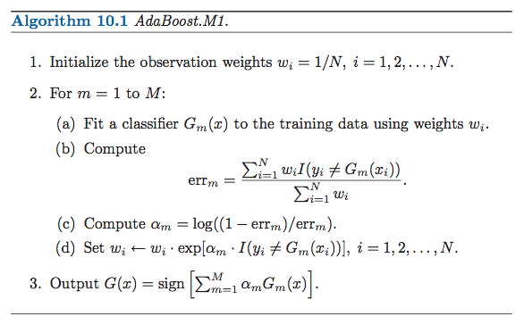
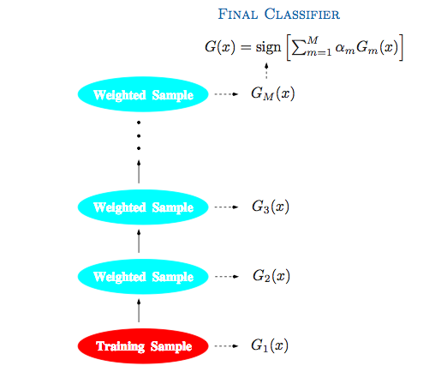
Popular ensemble methods
Boosting– A process for combining many weak learners into a powerful strong learner. The two most popular methods are AdaBoost and Gradient Boosted Trees. These are two of the most powerful and popular out-of-the box ensemble methods.
Intuition: use observed classification errors to reweight examples. At each iteration, incorrectly classified examples are upweighted so the model focus more on the hard to predict examples.
Image source: ESL2

Slide 5
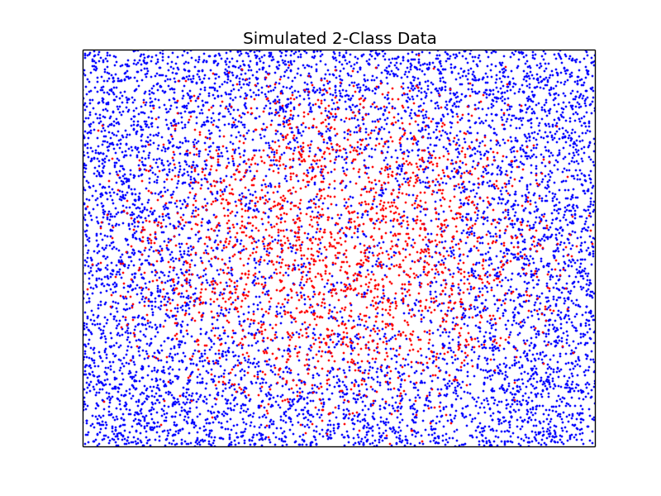
contents

Slide 6
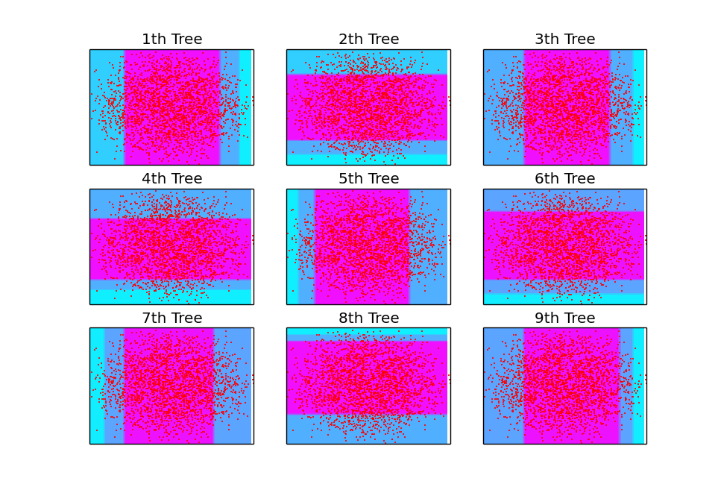
contents

Slide 7
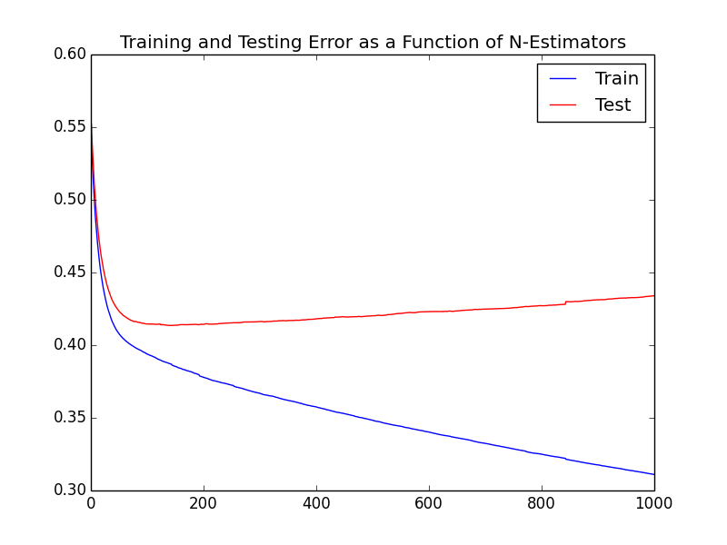
contents

Slide 8
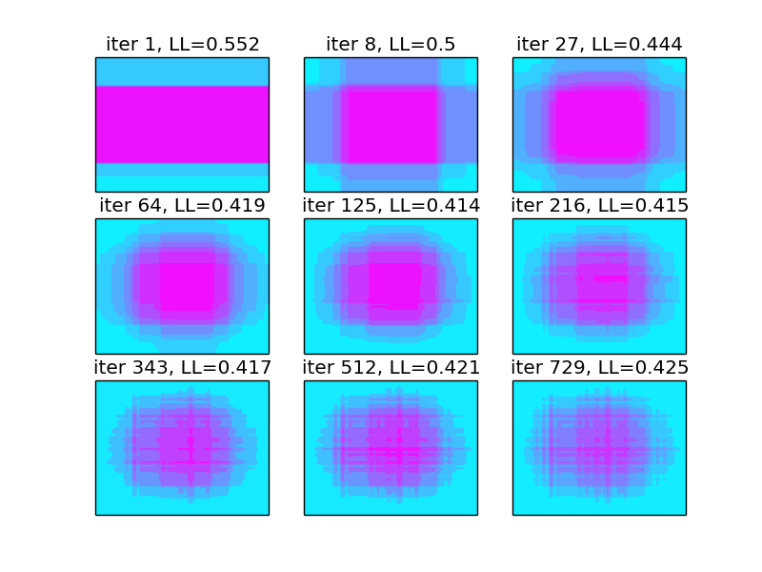
contents

